Slide 1
Drinking and Driving
Shelby Brownewell

Slide 2
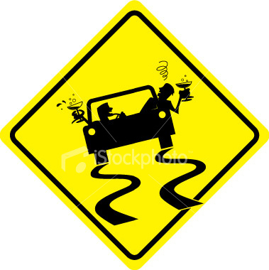
Give you false confidence, which makes you think you're driving better than you actually are.

Slide 3
Alcohol is a depressant that affects vision, coordination, reaction time, and judgment.

Slide 4
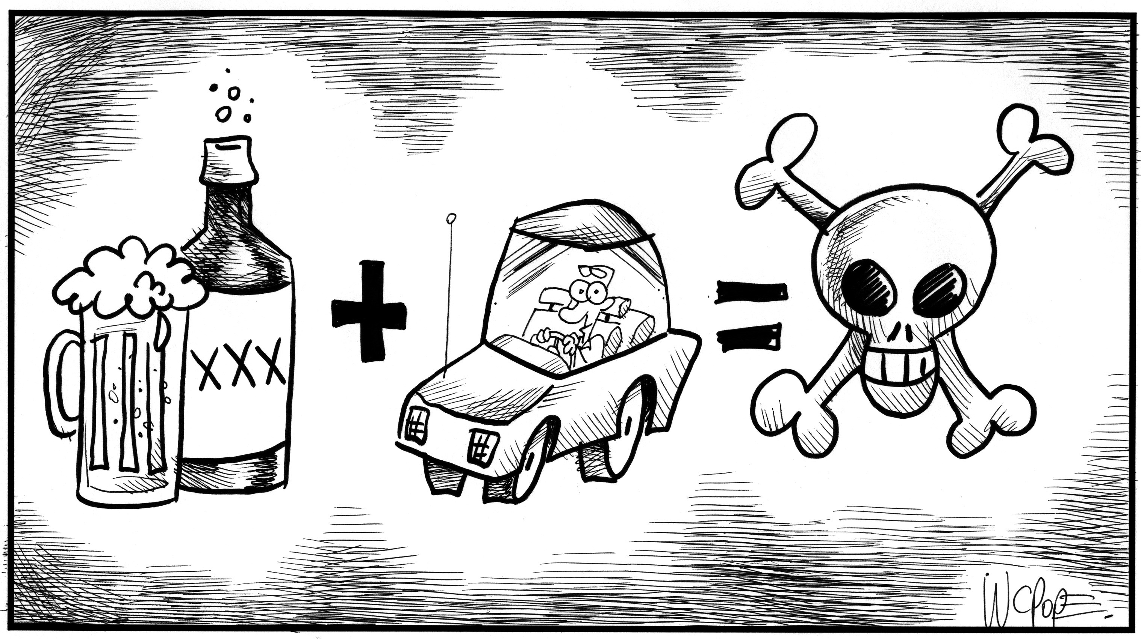
Every 53 minutes in America, a life is lost in a drunk driving crash, which is 27 life's a day.

Slide 5
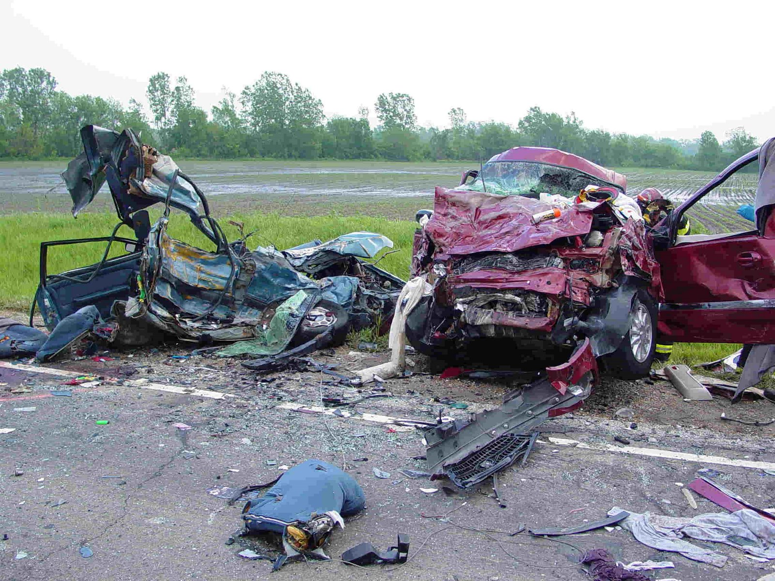
Drunk driving causes approximately one-third of all traffic fatalities in the United States.

Slide 6
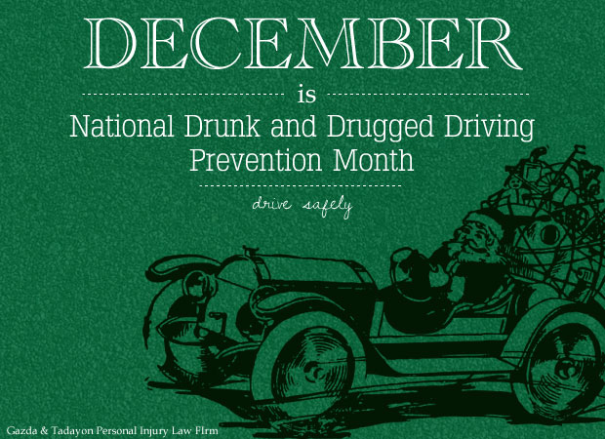
December is Drunk and Drugged Driving Prevention Month

Slide 7
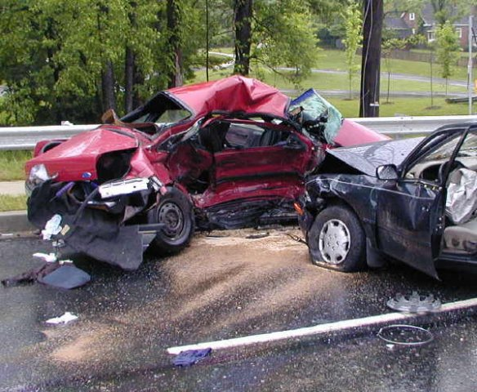
82% of fatal crashes are caused by drunk drivers

Slide 8
More people tend to get drunk at night time than in daytime.

Slide 9
www.truthaboutdrugs.org

